Slide 1
Final Test Machine Learning
Divira Iga Firdianti (021202100035)
Trianto Haryo Nugroho (021202100041)
Sofianita (021202100040)

Slide 2
INSURANCE OVERVIEW
An actuary is an expert working in the field of measurement and management of risk and uncertainty in business.
An insurance claim is a request for your insurance company to pay for something your insurance covers, such as a car accident, a house fire or visit to the emergency room.
Insurance fraud is any act committed to defraud an insurance process. It occurs when a claimant attempts to obtain some benefit or advantage they are not entitled to, or when an insurer knowingly denies some benefit.

Slide 3
INSURANCE CLAIM FRAUD PREDICTION
As an actuary one of our duties is to minimize the occurrence of insurance claim fraud. So, we are using machine learning methods that are used to predict the data of prospective insurance policy holders in order to find out whether there is a possibility of fraudulent insurance claims.
We use 4 methods to predict the insurance claim fraud as follows :
Decision Trees
K-Nearest Neighbors
Support Vector Machines
Neural Networks

Slide 4
Feature Importance
Feature importance refers to techniques that assign a score to input features based on how useful they are at predicting a target variable.
Feature importance scores play an important role in a predictive modeling project, including providing insight into the data, insight into the model, and the basis for dimensionality reduction and feature selection that can improve the efficiency and effectiveness of a predictive model on the problem.

Slide 5
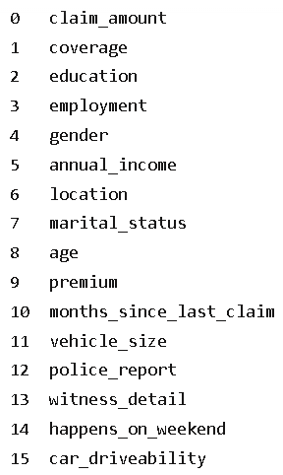
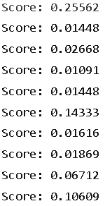
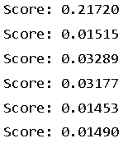
Feature Importance’s Score

Slide 6
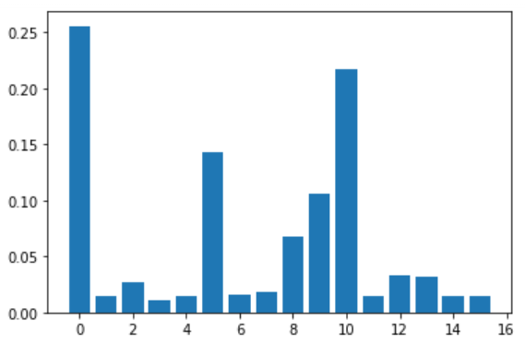
Feature Importance Bar Chart

Slide 7
Feature Selection
First, we choose 3 features namely claim_amount, months_since_last_claim, and annual_income. We choose these three features because they have the top 3 importance score, which means the most useful at predicting a target variable.
In the revision step, we add more features to 4, 5, and all features except cust_ID (16 features) and then reduce it to 2 and 1 feature and finally compare the accuracy, AUC, and running time to find the most accurate and efficient model.

Slide 8
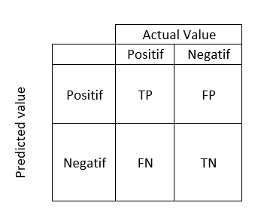

Model Evaluation
Accuracy : Accuracy is the most intuitive performance measure and it is simply a ratio of correctly predicted observation to the total observations

Slide 9
Model Evaluation
AUC : AUC is the probability that a randomly selected subject with the condition has a test result indicating greater suspicion than that of a randomly chosen subject without the condition.
Running time : Running time is the needed time for model to run (model eficiency) the time. The less time the more eficient the model.

Slide 10
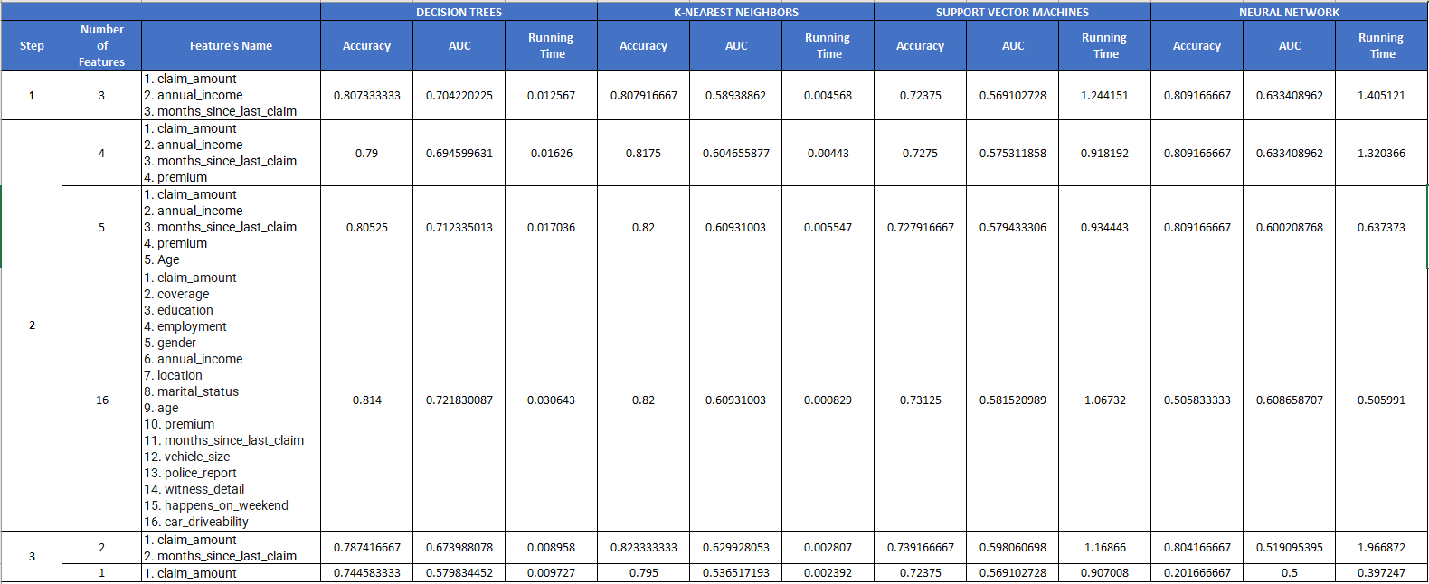
Comparison Table

Slide 11
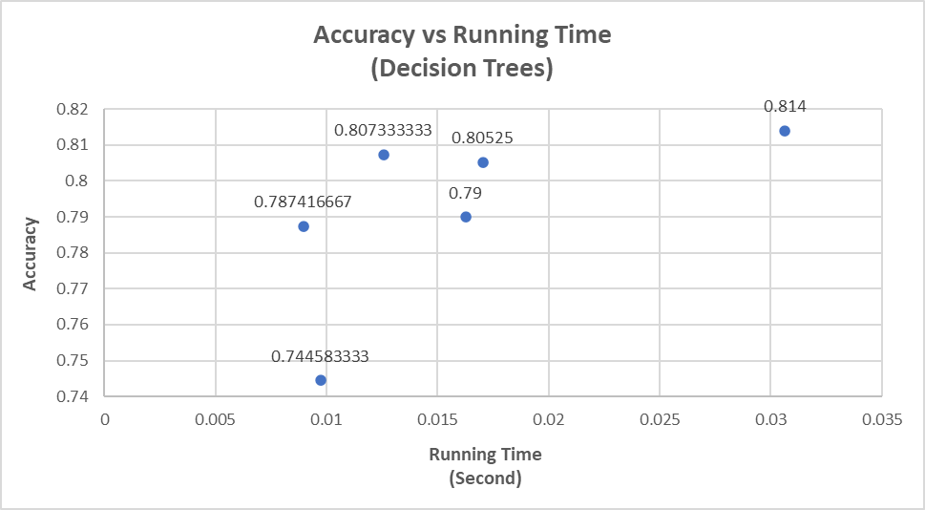
Decision Trees
Method : Decision Tress
Running Time = 0.012567
Number of Features : 3
Features Name :
1. claim_amount
2. coverage
3. months_since_last_claim

Slide 12
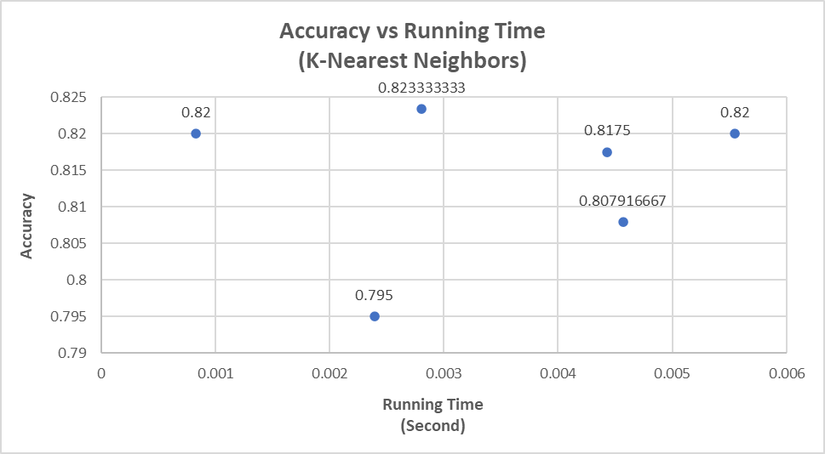
K-Nearest Neighbors
Method : K-Nearest Neighbors
Running Time = 0.000829
Number of Features : 16
Features Name :
1. claim_amount
2. coverage
3. education
4. employment
5. gender
6. annual_income
7. location
8. marital_status
9. age
10. premium
11. months_since_last_claim
12. vehicle_size
13. police_report
14. witness_detail
15. happens_on_weekend
16. car_driveability

Slide 13
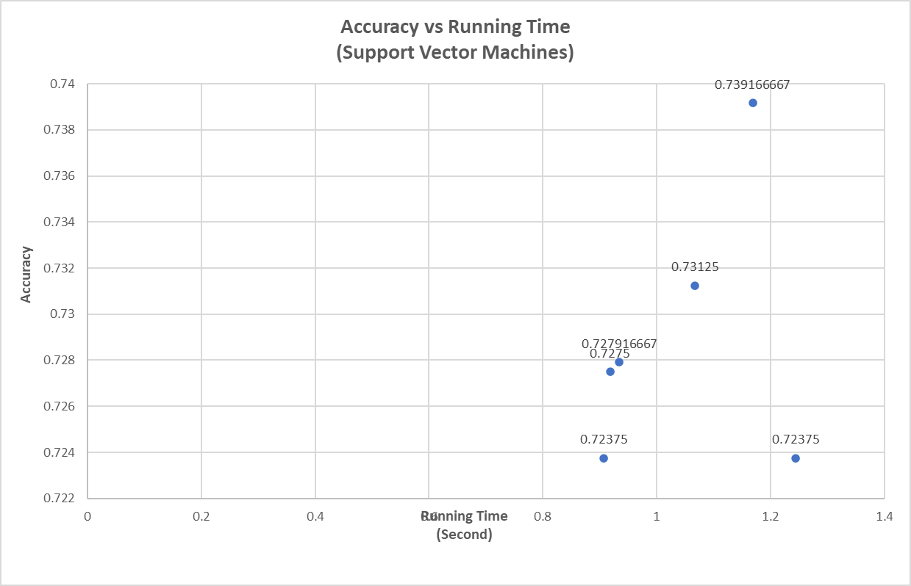
Support Vector Machines
Method : Support Vector Machines
Running Time = 0.918192
Number of Features : 4
Features Name :
1. claim_amount
2. annual_income
3. months_since_last_claim
4. premium

Slide 14
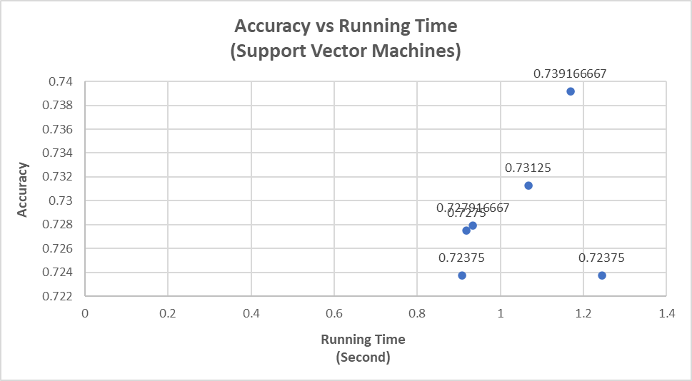
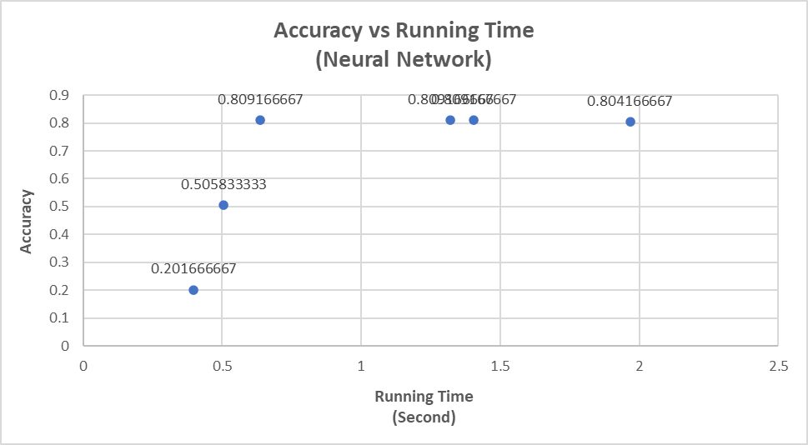
Neural Networks
Method : Neural Networks
Running Time = 0.637373
Number of Features : 5
Features Name :
1. claim_amount
2. annual_income
3. months_since_last_claim
4. premium
5. Age
Notes:
berdasarkan garis dilihat bahwa ada 3 titik akurasi yang berdekatan, kemudian kita pilih titik yang paling kiri karena waktu yang paling kecil

Slide 15
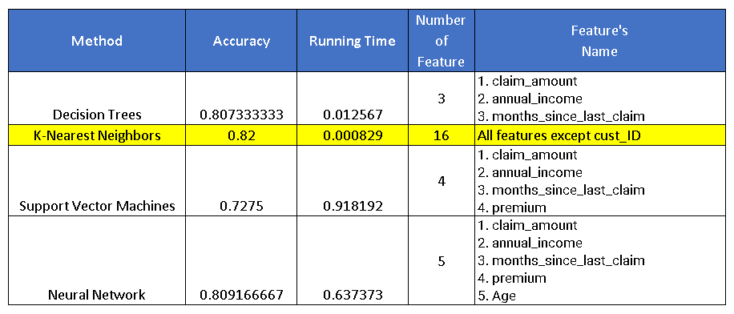
Conclusion
Comparing 4 graph above we find the best model with optimum accuracy and efficiency which is using K-Nearest Neighbors with 16 features selected.

Slide 16
Thank You!

